Slide 1


JPA overview

Slide 2

Inhoud
“Persistence”
What is “Persistence” Problems JPA Components
Creating a jpa example project
Creating a new project Creating an Entity 'Bread' Creating BreadRepository Creating BreadController Creating the user interface Linking the database Completing the BreadController and User Interface Keyword query methods Jpql Exposing the API Api testing via Postman testing script
More about how the Spring framework works
Spring Component Scanning Inversion of Control Dependency Injection Documentation

Slide 3
What is "Persistence"
retention of application data for later use
Maximum scope of objects = application. When the application is closed, all objects are gone (and the values of their attributes) => capture (=make persistent) all attribute values of all objects in a database
Why ?
“data lives longer than any application does.”
How?
store data in a relational database such as MySQL, Oracle, ...

Slide 4
Persistence: problems
“Impedance mismatch”
= difference in approach between object-oriented and relational data structure https://en.wikipedia.org/wiki/Object-relational_impedance_mismatch
Granularity
RDBMS has limited number of data types Fine-meshed data structure not desirable in RDBMS based on performance
Inheritance and Polymorphism
Not provided in RDBMS
Identity of an object
Database : rows are equal if primary key is equal OO
“Object identity” : object1 == object2
“Object equality” : object1.equals(object2)

Slide 5
Persistence: problems
Associations between objects
Relationships between database tables are by definition
Unidirectional (via foreign keys) 1 to many(1---*) or 1 to 1 (1---1) *----* is not possible in a relational database but is possible in an OO Class Diagram
Data retrieval
In OO: navigating from Object to Object In database: retrieve as few tables as possible per query

Slide 6
Persistence
We want to solve the difference between the relational model and the class diagram with
Rules that describe how to map an object to a row in a table (object relational mapping = ORM) An easy way to make objects persistent (CRUD operations)

Slide 7
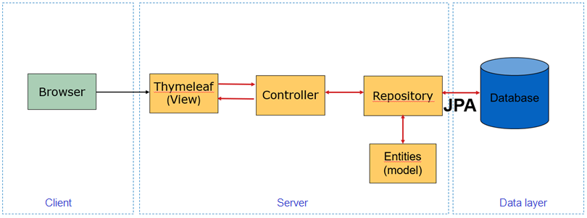
JPA
Java Persistence API (JPA) is the standard object/relational mapping interface that allows us to make Java objects persistent in a relational database.
In the remainder of this presentation we explain the above based on an example project

Slide 8
Creating a JPA example project

Slide 9
Contents
This presentation will guide you through the process of creating a JPA project in IntelliJ starting from the empty project “startingproject.zip” Follow these instructions carefully and you will learn what to do and how to do it. You must also be able to do this for the exam. Note: this example will not work if you have not installed the database correctly with the settings we use in these lessons. So go through the steps in advance in the document "Installation of MySQL 2023" + "Configuring MySQL for JPA 2023" on Canvas The project that came with this item only serves in case you fail to make it yourself. It is best to use the (tele)coaching if you fail to make the project... Important tip: in the construction of the project it is possible that you have to (re)compile and (re)run several times: run File > Invalidate Caches/Restart... Good luck!

Slide 10
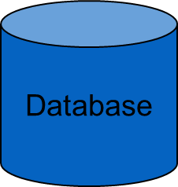
JPA example project
RequestMapping
JpaRepository
add.html
(view)
Inheritance
Browser
index.html
(view)
BreadController
(controller)
BreadRepository
(data access in repository)
JPA
edit.html
(view)
Bread
(=entity in model)
Association
Client
Server
Data layer

Slide 11
Creating a JPA example project in IntelliJ
Step 1: Creating a Web project using the JPA Framework Step 2: Creating an entity "Bread" in the model package Step 3: Creating a repository class related to the "Bread" entity Step 4: Creating the BreadController Step 5: Creating the user interface

Slide 12
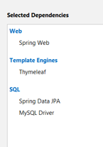
Step 1: Open the startproject
Download the startproject.zip
unzip en rename the project and put it in your corresponding GitHub-folder
Open IntelliJ en open this project
This project has additional dependencies being:

Slide 13
Step 2: Creating an Entity 'Bread'
Some characteristics of an Entity:
Can become persistent in the relational database:
Each Entity corresponds to a table in the database, and an object of this class corresponds to a record in this table
Supports transactions Supports inheritance Is identified by a persistence id
= the primary key of the table preferably generated by the database
Attributes match the fields in a table
getters & setters for all attributes are needed to retrieve and save the data
How do we turn a class into an Entity? Via annotations. Each annotation:
Starts with @
Relates to the line of code immediately after the annotation

Slide 14
Step 2: Creating an Entity 'Bread'
Annotations:
@Entity
annotation that makes it clear that this is not just a class, but a class whose objects can be made persistent in the database Convention = if you do not give details about the table to be made, then the table gets the same name as the class starting with a lowercase letter. The columns also get the names of the attributes. => When you create an Entity Bread, a Bread object will be stored in the bread table.
@Id
This annotation indicates that the attribute corresponds to the primary key of the record
@GeneratedValue(strategy = GenerationType.AUTO)
This annotation indicates that a newly created object will have the primary key generated by the database

Slide 15
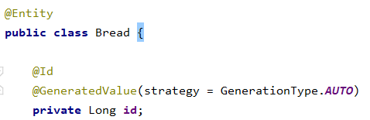
Step 2: Creating an Entity 'Bread'
First create the model package and create the Bread class. Complete the Bread class with the following code
And let IntelliJ perform the standard imports that go with it Then complete the entity with the attributes:
name: String
price: double
Click right in the code and choose insert code...
Generate no-arg constructor: you can do this but it’s not strictly necessary. If you do not have a constructor, Java will call the default constructor (see lesson 3 Classes and objects of 1ITF Java) Generate getters and setters...

Slide 16
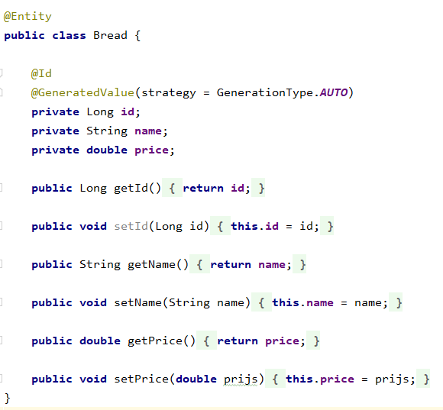
Step 2: Creating an Entity 'Bread'
Newly added code

Slide 17
Step 3: Creating BreadRepository
A Repository in Spring Boot
is a mechanism to get access to the database (CRUD operations). This is done through annotations and inheritance. in other words, the BreadRepository Interface that we are going to create will make the values stored in an object of the Entity class Bread persistent in the database and can also retrieve the corresponding data from the database and modify it. the BreadRepository inherits from another class which in turn inherits from another etc... This mechanism ensures that you can use a lot of interesting "pre-programmed" methods via this interface such as:
Retrieve all records from the "Bread" table and fill a List<Bread> with it Add a new record in the "Bread" table based on the attribute values of a newly created object Customize the fields of an existing record in the "Bread" table based on an object's modified attribute value Delete a record from the "Bread" table when the corresponding object is deleted

Slide 18
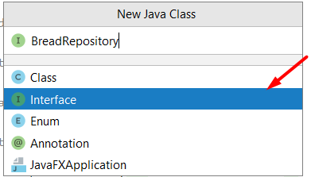

Step 3: Creating BreadRepository
First create the package repository and create a New.. Java class after which you choose Interface in the list and then enter the name BreadRepository:
Complete this interface with the following code:
And let IntelliJ perform the standard imports that go with it

Slide 19
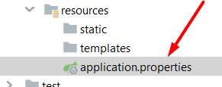
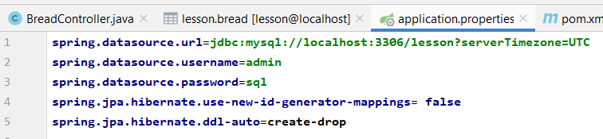
Step 3: Creating BreadRepository
To create the link to the database, you must also provide the necessary settings in the application.properties file. Open this file:
Copy and paste the following code here:
spring.datasource.url=jdbc:mysql://localhost:3306/lesson?serverTimezone=UTC spring.datasource.username=admin spring.datasource.password=sql spring.jpa.hibernate.use-new-id-generator-mappings= false spring.jpa.hibernate.ddl-auto=create-drop
This code provides the link to your lesson database lesson and when you run your application, the database will first be emptied, so that you always start "with a clean slate"...

Slide 20
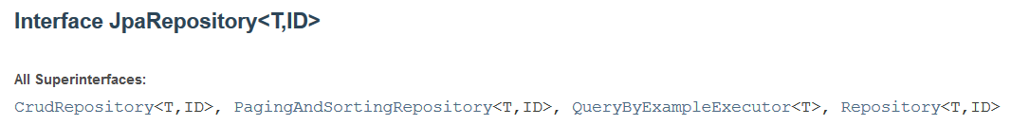
Step 3: Creating BreadRepository
BreadRepository inherits from JpaRepository<T, ID> which in turn also inherits from other super interfaces
JpaRepository is a generic interface:
the interpretation of which entity and what type of ID will be used to perform CRUD operations, has yet to be given in this example: <T, ID> => <Bread, Long>

Slide 21
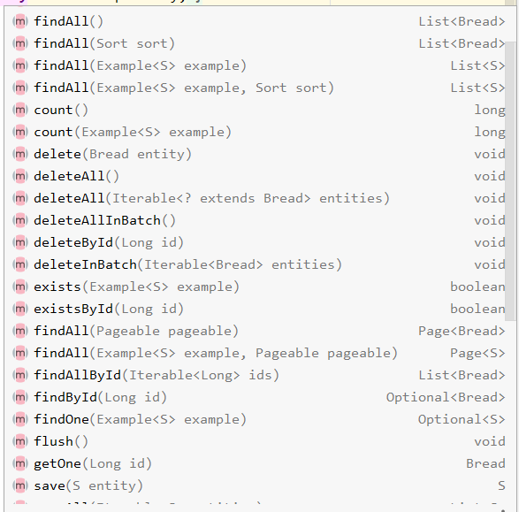
Step 3: Creating BreadRepository
In this way you can use a lot of interesting methods to do CRUD operations on the database such as:
For the implementation of these CRUD methods, the JPA framework is used

Slide 22
Step 3: Creating BreadRepository
Interesting CRUD Methods:
List<Bread> findAll()
creates an object of the Bread class for each record in the bread table, and sets the attribute values to the values in the table
long count()
specifies the number of records in the bread table
void delete(Bread entity)
deletes the corresponding record in the bread table
Optional<Bread> findById(Long id)
this method returns an optional : value that can also be null if this method does not find a record with the given id. With the .get() method of the return value, you can retrieve the found bread object.
S save (S entity)
saves the object in the database: if no record exists yet, a new one is created, when the record already exists, the corresponding values are adjusted with the new values of the attributes ….

Slide 23
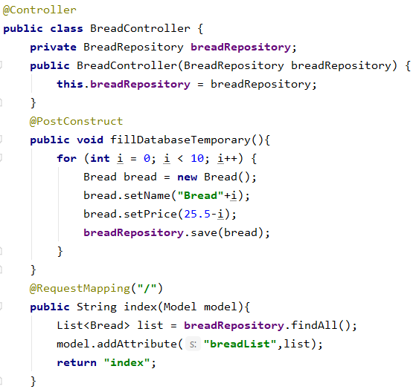
Step 4: Creating BreadController
First, create the package “controller” and then create the BreadController class inside this package. Complete the BreadController class with the following code (and do the required imports)
Association with BreadRepository set via the constructor
@PostConstruct ensures that the fillDatabaseTemporary() method runs after the BreadController constructor has been called and that the index.html is displayed.
The created Bread object is stored in a table “bread”.
If you surf to localhost:8080, this method will be performed first. All records in the bread table are converted to Bread objects and placed in a list.

Slide 24
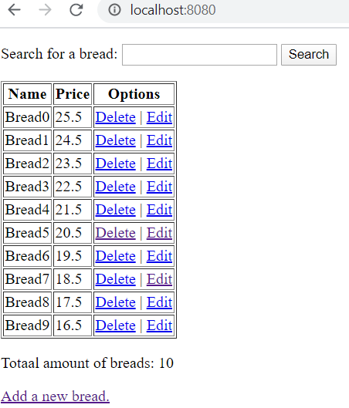
Step 5: Creating the Userinterface
index.xhtml

Slide 25
Step 5: Creating the Userinterface
Create a Thymeleaf HTML file index in the package templates and complete the "body" with the following code:
<form action="/search" method="post"> <p> <label for="searchstring">Search for a bread: </label> <input type="text" name="searchstring" id="searchstring"> <input type="submit" value="Search" name="searchname"> </p> </form> <table border="1"> <tr> <th>Name</th> <th>Price</th> <th>Options</th> </tr> <tr th:each="bread : ${breadList}"> <td th:text="${bread.getName()}"></td> <td th:text="${bread.getPrice()}"></td> <td> <a th:href="@{/delete(breadId=${bread.getId()})}">Delete</a> | <a th:href="@{/edit(breadId=${bread.getId()})}">Edit</a> </td> </tr> </table> <p th:text="'Totaal amount of breads: ' + ${breadList.size()}"></p> <a href="/add">Add a new bread.</a>
Run your project. If everything goes well, you will get the screen that was in the previous slide... The links and buttons don't work yet, because we haven't written the corresponding mapping methods in the BreadController yet...

Slide 26
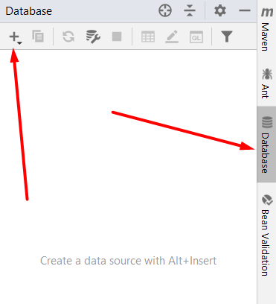
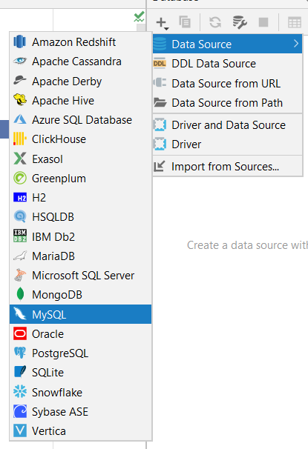
Linking the database…
To see the result of your code in the database, you can open MySQL Workbench or work via IntelliJ. Here's how:
Click on Database in the left margin and then on "+">Data source>MySQL

Slide 27
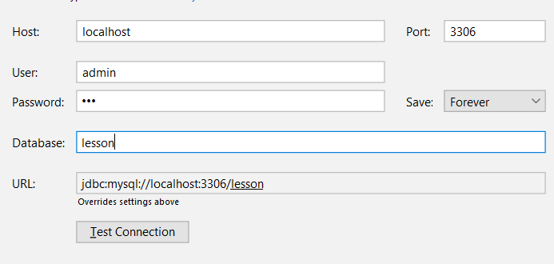
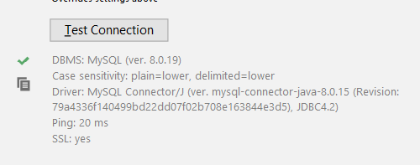
Linking the database…
Enter the connection values (as in the application.properties-file):
Click on "Test Connection" and if everything goes well you will get this result:

Slide 28
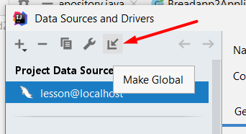
Linking the database…
Then click on the icon at the top left of the properties window:
You now make this database connection "global" for your entire IntelliJ environment. Clicking on your database tab in the right margin will immediately connect you to this database... Click OK so that the properties window closes.

Slide 29
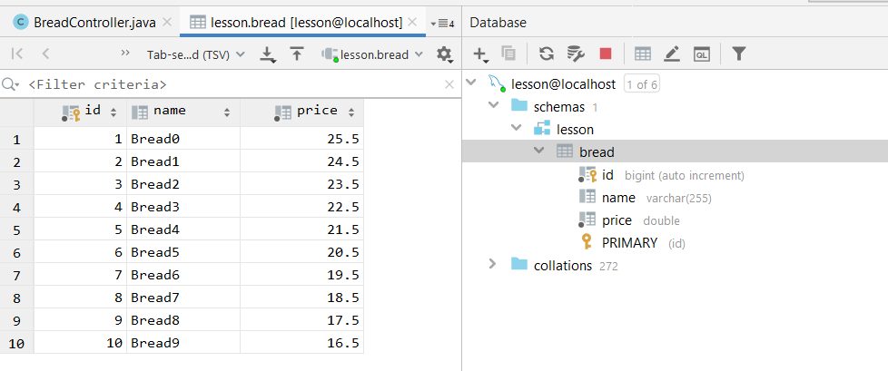
Linking the database…
To see the full contents of a table, double-click the table...

Slide 30
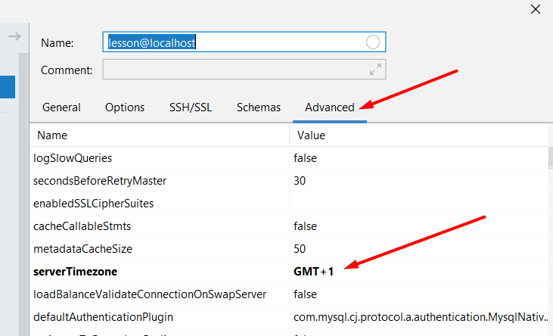
Linking the database…
If you don't see the content, but get this error:
Then go (back) to the properties window of your database click on tab Advanced where you have to set the setting "serverTimezone" like this:
After that, click Apply and OK and try again...

Slide 31
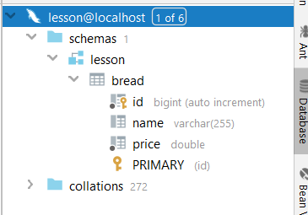
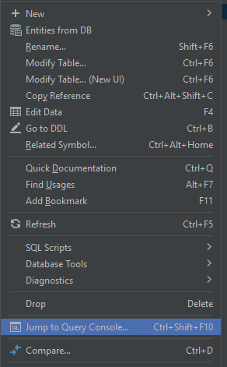
Linking the database…
You will then see your lesson database with the "bread" table in it:
Right-click the bread table and click “Jump to Query Console” to run queries and see the results.

Slide 32
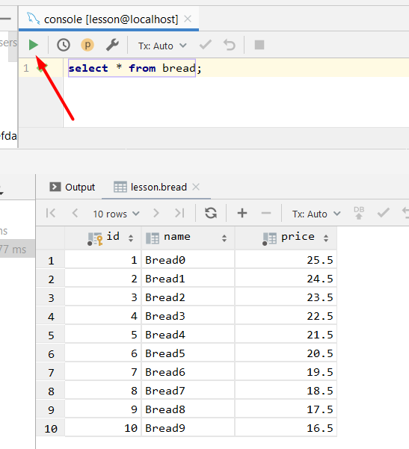
Linking the database…
Type query and click on the green triangle: this gives the result of your query at the bottom of the screen:

Slide 33

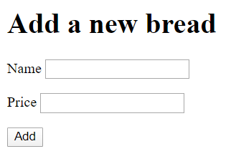
Completing the BreadController and user interface
Add the following method in BreadController:
Create a new Thymeleaf page, add.html, and insert the following code in the "body":
<h1>Add a new bread</h1> <form action="/processadd" method="post"> <p> <label for="name">Name</label> <input type="text" name="name" id="name"> </p> <p> <label for="price">Price</label> <input type="text" name="price" id="price"> </p> <p> <input type="submit" value="Add" name="add"> </p> </form>

Slide 34
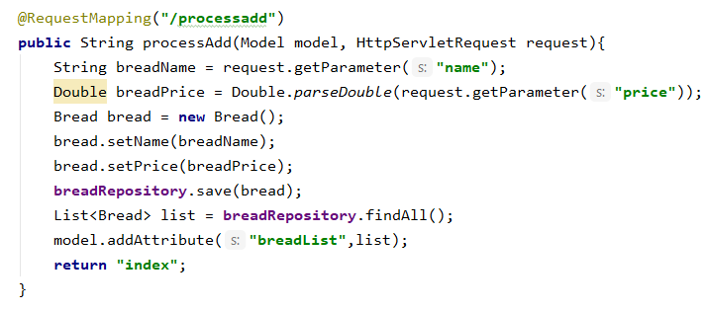
Completing the BreadController and user interface
Add the following method to the BreadController:
Run your project and test the link "add a new bread"...

Slide 35
Completing the BreadController and user interface
We are now also completing the code behind the links "edit" and "delete". Copy the code below to your BreadController (if you copy first to notepad and then to IntelliJ, the strange ppt characters will disappear...):
@RequestMapping("/edit") public String edit(Model model, HttpServletRequest request){ Long breadId = Long.valueOf(request.getParameter("breadId")); //breadRepository.findById(breadId) returns an Optional, a value that can also be null. By using the .get()-method we can retrieve the actual value. Bread bread = breadRepository.findById(breadId).get(); model.addAttribute("bread", bread); return "edit"; } @RequestMapping("/processedit") public String processEdit(Model model, HttpServletRequest request){ Long breadId = Long.valueOf(request.getParameter("breadId")); String breadName = request.getParameter("name"); Double breadPrice = Double.parseDouble(request.getParameter("price")); Bread bread = breadRepository.findById(breadId).get(); bread.setName(breadName); bread.setPrice(breadPrice); breadRepository.save(bread); List<Bread> list = breadRepository.findAll(); model.addAttribute("breadList",list); return "index"; } @RequestMapping("/delete") public String delete(Model model, HttpServletRequest request){ Long breadId = Long.valueOf(request.getParameter("breadId")); breadRepository.deleteById(breadId); List<Bread> list = breadRepository.findAll(); model.addAttribute("breadList",list); return "index"; }
We can retrieve an object from the "id" in the table. This "id" is of the Type Long, so we first have to convert it from String to Long in order to then use the "findById" or "deleteById" method.
Note: we also need to call the .get() method of the findById return value to get the object back itself.

Slide 36
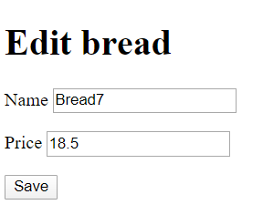
Completing the BreadController and user interface
Finally, create a final Thymeleaf HTML page: edit and copy this code into the body:
<h1>Edit bread</h1> <form th:action="@{/processedit(breadId=${bread.getId()})}" method="post"> <p> <label for="name">Name</label> <input type="text" name="name" id="name" th:value="${bread.getName()}"> </p> <p> <label for="price">Price</label> <input type="text" name="price" id="price" th:value="${bread.getPrice()}"> </p> <p> <input type="submit" value="Save" name="save"> </p>
Test your code. Everything should work except the search function...
breadId will simply be retrievable via the request.getParameter method, just like the other form elements. You have to use the post-method for this...

Slide 37
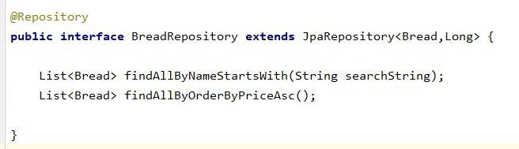
Create Keyword query method for searching
the standard crud methods are often not sufficient
For example, you cannot search for a (part of) a value of a certain attribute...
Open the BreadRepository Interface and add the following "Keyword queries":
You'll notice that IntelliJ automatically completes it...
These are extra pre-programmed methods that you can call and that can be built depending on the attributes of Bread. The keyword query runs the following native SQL code in the background :
findAllBy => select * from bread
ByXXX => where …

Slide 38
Keyword query methods
LIKE Query Methods
The equivalent of the following MySQL query
SELECT * FROM movie WHERE title LIKE '%in%’;
Can be converted into keyword query methods:
List<Movie> findByTitleContaining(String title);
List<Movie> findByTitleContains(String title);
List<Movie> findByTitleIsContaining(String title);
All 3 methods give the same result…
The equivalent of the following MySQL query
SELECT * FROM movie WHERE title LIKE 'in%’;
Can be converted into keyword query methods:
List<Movie> findByTitleStartsWith(String title);
The equivalent of the following MySQL query
SELECT * FROM movie WHERE title LIKE ‘%in’;
Can be converted into keyword query methods:
List<Movie> findByTitleEndsWith(String title);

Slide 39
Keyword query methods
Examples of keyword queries with Order By
List<Person> findByLastnameOrderByFirstnameAsc(String lastname);
List<Person> findByLastnameOrderByFirstnameDesc(String lastname);
Attention! If you want to sort a list (without a where clause) you still have to repeat "By":
List<Person> findAllByOrderByFirstnameDesc();
Tip! Use ctrl spacebar to build your keyword queries Other possibilities see:
https://docs.spring.io/spring-data/jpa/docs/1.4.3.RELEASE/reference/html/repositories.html
https://docs.spring.io/spring-data/jpa/docs/1.4.3.RELEASE/reference/html/repository-query-keywords.html
If you have written the Keyword query methods in the Repository Interface, you can use them in the Controller class...

Slide 40
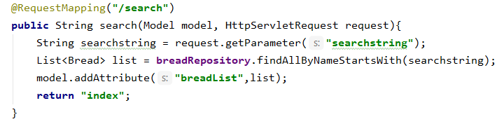
Create Keyword query method for searching
Open the BreadController and add the following method:
Then replace the "findAll()" methods with the "findAllByOrderByPriceAsc()" in the following RequestMapping methods:
index(Model model)
processAdd (Model model, HttpServletRequest request)
processEdit-methodes (Model model, HttpServletRequest request)

Slide 41
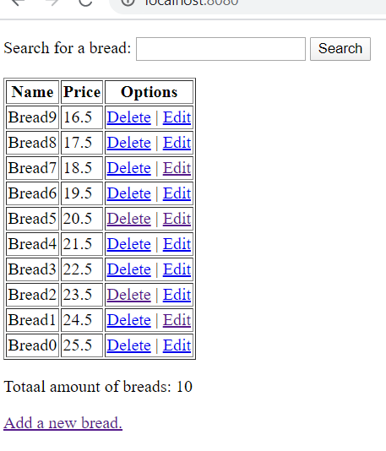
Test your project
Start your project... The loaves of bread are now sorted in ascending order of price... Add some loaves of bread Also test the Edit and Delete links... Also check what the result in the database looks like When errors occur, read what it says in the output window and try to fix your error(s) based on this...

Slide 42
JPQL
Keyword queries have their limitations. You can run simple queries with this, but if you want to run a more complex query, JPQL is recommended. JPQL = JPA Query Language: JPA's query language is very similar to SQL
JPQL is Java code (and NOT SQL) and therefore:
the queries are completely OO, with possibilities such as inheritance, polymorphism, association. You don't have to write joins often when you work OO we use the names of the attributes (of the Entity) and not the column names (from the corresponding table) making the query database independent The JPA framework provides:
the translation from JPQL to SQL converting the records (with different field values) from a table to Java objects with corresponding attribute values
The syntax in the queries is not case-sensitive:
seLEct or SELECT or select or Select is identical
The names of the classes and the attributes used in the queries are CASE-sensitive!
Bread is not the same as BREAD or bread! Bread.name's not the same as Bread.name!

Slide 43
Simple query
As an alternative to List<Bread> findAllByOrderByPriceAsc(); you can also use JPQL:
SELECT b from Bread b order by b.price asc
You select all instances of the entity Bread In the background, "Select * from bread order by price asc" is executed, and all records from the bread table become objects of the Bread class You are required to create an alias for each entity. This alias is used to name an instance/object of the entity
One chooses to use one lowercase letter for the alias
SELECT b from Bread b WHERE b.name = ‘white bread'
name refers to an attribute of the class so don't write
SELECT b from Bread b WHERE b.NAME = 'white bread'
Error message "could not resolve property"

Slide 44
Operators for WHERE
Comparing values
= <> > >= < <=
Link multiple conditions
AND OR
Use parentheses if necessary Mathematical operators
+ - * /
[NOT] BETWEEN
E.g.: WHERE b.price BETWEEN 1.15 AND 2.75
[NOT] LIKE
_ %
E.g.: WHERE b.name LIKE '%tarwe%'

Slide 45
Operators for WHERE
[NOT] IN
E.g.: WHERE b.name NOT IN (‘sugar bread', ‘raisin bread')
IS [NOT] EMPTY
Do you use if one of the properties is a collection class eg: WHERE x.members IS EMPTY
IS [NOT] NULL
E.g.: WHERE b.name is null
NOT
To ignore a condition
[NOT] EXISTS (subquery)
exists returns true if the subquery returns values
{ALL|ANY|SOME} (subquery)
See below

Slide 46
JPQL functions
ABS
SQRT
MOD
CURRENT_DATE
CURRENT_TIME
CURRENT_TIMESTAMP
CONCAT
SUBSTRING
TRIM
LOWER
UPPER
LENGTH
LOCATE
Find out more: http://download.oracle.com/docs/cd/E14571_01/apirefs.1111/e13946/ejb3_overview_query.html

Slide 47
Aggregations
COUNT returns a Long MAX, MIN
AVG returns a Double SUM
returns a Double if you work with decimal numbers returns a Long if you work with integers
You can also use DISTINCT in combination with the previous

Slide 48
Even more
ORDER BY
Standard ascending E.g.: SELECT b FROM Bread b ORDER BY b.price desc, b.name asc
GROUP BY
HAVING
Note: in where, order by or group by you may not use calculations
So NOT: ORDER BY SUM(leden.price) DESC WHERE AVG(leden.gewicht) > 65

Slide 49
Use JPQL in the example project
Open BreadRepository
In the current version of your project, the keyword query was used:
List<Bread> findAllByOrderByPriceAsc();
You didn't have to program anything for this You also get the same result if you solve this with JPQL.
Now delete the method above (or put it in comment) and add the following code in your BreadRepository. NB You can/may call the method differently what we have also done to prove this ... for example:
@Query("select b from Bread b order by b.price ASC") List<Bread> giveListOfAllBreadsOrderedByPrice();
After the @Query you still have to have the import done by IntelliJ In the BreadController you must of course also replace every use of the findAllByOrderByPriceAsc() method with giveListOfAllBreadsOrderedByPrice()

Slide 50
Use JPQL in the example project
We add another functionality: Suppose you want to get the cheapest Bread from the list. To solve this, you must first look for the lowest price (select min(b.price) from Bread b).
Then you will select those breads whose price is equal to the lowest price you found via the previous query: select b from Bread b where b.price in (select min(b.price) from Bread b)
We add this JPQL syntax in the BreadRepository as follows:

Slide 51
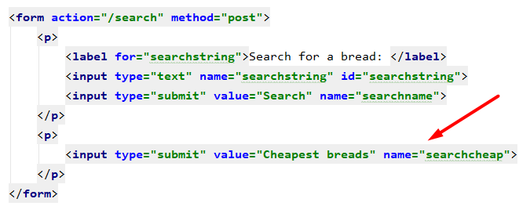
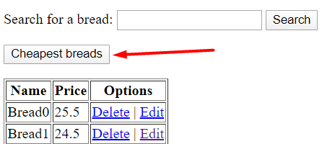
Use JPQL in the example project
In the index we add a button at the top

Slide 52
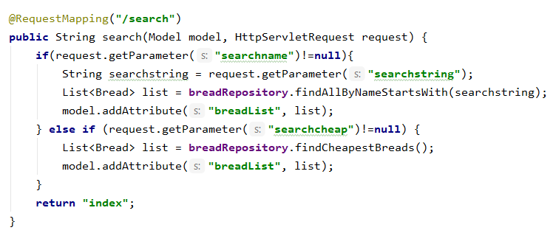
Use JPQL in the example project
in BreadController we modify the method that comes after the RequestMapping("/search")

Slide 53
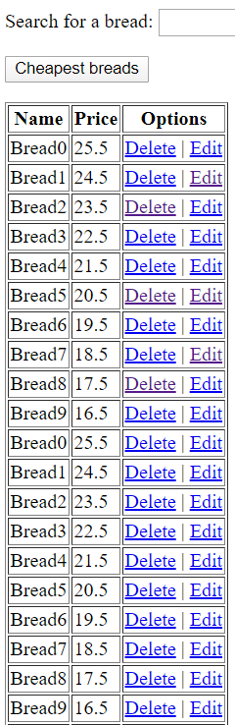
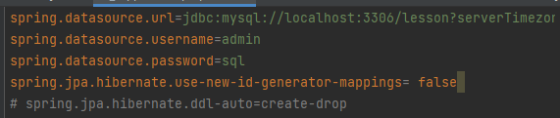
Use JPQL in the example project
To try out the test of this method, we are going to put the following code in the application.properties-file in comments
Every time you run your application now, the table will be dropped and recreated.
If you want to keep your table and the records that you have created / changed / deleted, change the setting spring.jpa.hibernate.ddl-auto=create-drop to spring.jpa.hibernate.ddl-auto=update
But every time you rerun your application 10 more records will be added...

Slide 54
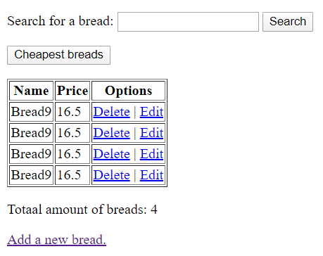
Use JPQL in the example project
After running the application again for 4 times, clicking on the "Cheapest breads" button will give the following result:

Slide 55
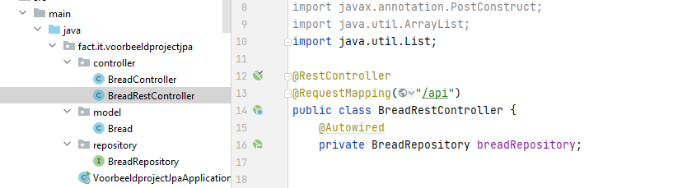
Exposing the API
The same "backend" that you have created can now also be offered in an easy way to other frontend applications via an API. Create a RestController for that (in the “controller” package)
Also make an association with your BreadRepository class
you can "autowire" it or have it instantiated via the constructor with a parameter

Slide 56
Exposing API
The services that you can easily offer are:
a service to retrieve all bread records from the database, sorted by price a service to retrieve all bread records from the database where the name starts with a particular name part a service to retrieve the cheapest bread records from the database a service to modify a bread record in the database. This service returns the custom bread object a service to remove a bread record from the database. This service does not give anything back

Slide 57
Exposing API: BreadRestController
//a service to retrieve all bread records from the database, sorted by price @GetMapping("/breads") public List<Bread> getBreads(){ return breadRepository.giveListOfAllBreadsOrderedByPrice(); } // a service to query all bread records from the database where the name starts with a certain
letter combination @GetMapping("/breads/search") public List<Bread> getBreadsNamePart(@RequestBody String namePart){ return breadRepository.findAllByNameStartsWith(namePart); } //a service to find the cheapest bread @GetMapping("/breads/searchcheapest") public List<Bread> getBreadsCheapest(){ return breadRepository.findCheapestBreads(); }

Slide 58
Exposing API: BreadRestController
//a service to add a bread record in the database. This service also returns the added bread object @PostMapping("/breads") public Bread createBread(@RequestBody Bread bread){ return breadRepository.save(bread); } //a service to modify a bread record in the database. This service returns the modified bread-object if found, if not, it returns HTTP 404 @PutMapping("/breads/{id}") public ResponseEntity<Bread> changeBread(@RequestBody Bread updateBread, @PathVariable long id){ Optional<Bread> bread1 = breadRepository.findById(id); if (bread1.isPresent()) { Bread bread=bread1.get(); bread.setName(updateBread.getName()); bread.setPrice(updateBread.getPrice()); breadRepository.save(bread); return new ResponseEntity<>(bread, HttpStatus.OK); } return new ResponseEntity<>(HttpStatus.NOT_FOUND); }

Slide 59
Exposing API: BreadRestController
//a service to remove a bread record from the database. This service returns the number of breads in the database @DeleteMapping("/breads/{id}") public ResponseEntity<Integer> deleteBread(@PathVariable long id) { Optional<Bread> bread1 = breadRepository.findById(id); if (bread1.isPresent()) { Bread bread = bread1.get(); breadRepository.delete(bread); return new ResponseEntity<>(breadRepository.findAll().size(), HttpStatus.OK); } return new ResponseEntity<>(breadRepository.findAll().size(), HttpStatus.NOT_FOUND);

Slide 60
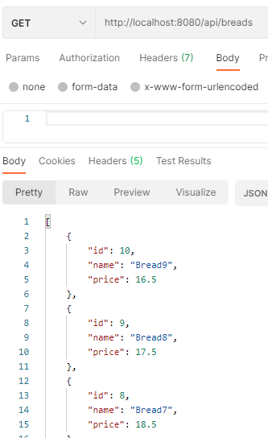
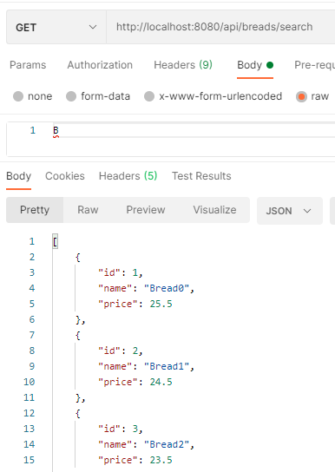
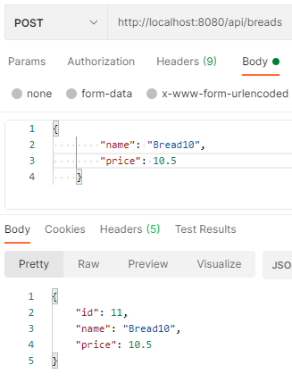
Exposing API: Test the API
Use Postman to test all your services...

Slide 61
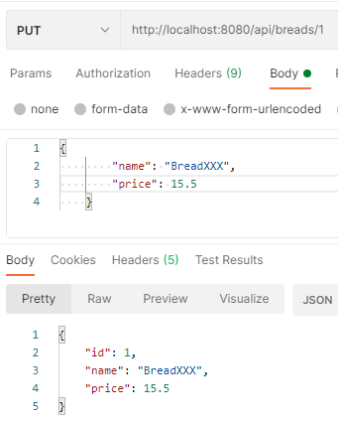
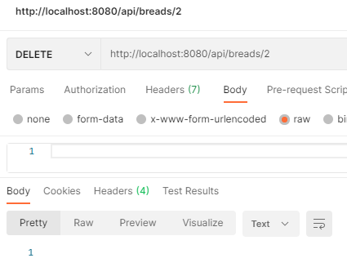
Exposing API: Test the API
Use Postman to try out all your services...

Slide 62
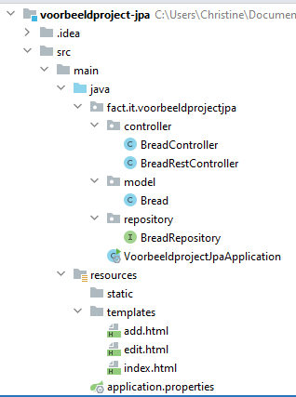
Summarized
The BreadController performs the same function as before: capturing html requests but now includes a "BreadRepository breadRepository" attribute to retrieve and write data The BreadRestController captures all requests from other frontend applications and provides answers/results in the form of a JSON or an XML. The BreadRepository provides access to the database. This allows you to use standard methods to perform CRUD operations or create new query methods using keyword queries or JPQL An entity object corresponds to a row in a table of the database. The attributes of an entity correspond to the columns of the table.

Slide 63
Testing the API via Postman testing script
If you've successfully tested all your services through Postman, you can also run the Postman test script we've put in place (lesson_bread.sql). All the tests that are included in this should therefore be successful.
On the exam we will also make such a script available for verification...
Necessary preparation:
Run sql script on the database put the @Postconstruct method that serves to populate the database in comments and modify the application.properties file
Load and run the Postman test script (Test breads.postman_collection.json) in Postman

Slide 64
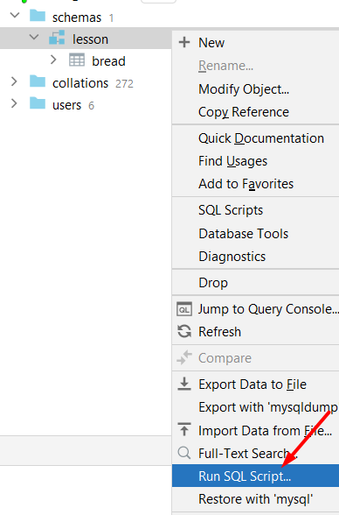
Run SQL script
you can easily run the sql script via IntelliJ right-click on the database "lesson" and choose "Run SQL Script..."
then click and run the downloaded script lesson_bread.sql

Slide 65
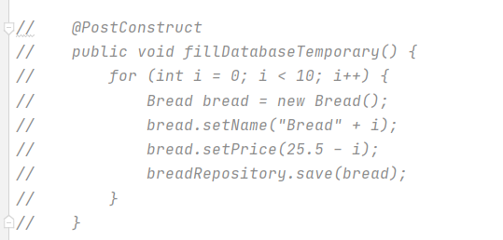
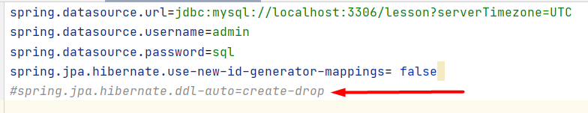
@PostConstruct method and properties-file
In @Controller-class:
In application.properties-file:
at the start of your application, nothing will be changed in the database
Now you run your project

Slide 66
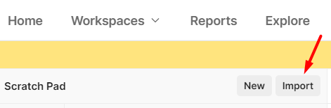
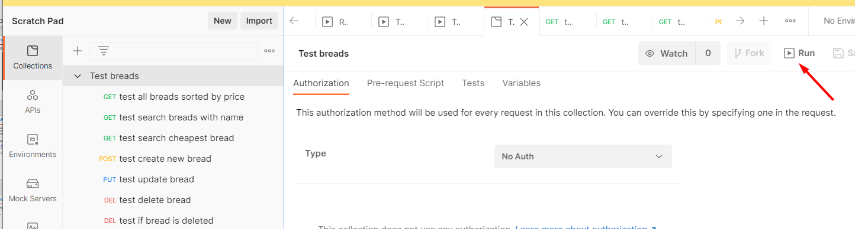
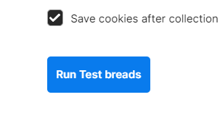
Load and run the Postman test script
Download Test breads.postman_collection.json
Start Postman and import this file via "import" (top left of your screen)
Then click "Run":
And finally, once again on

Slide 67
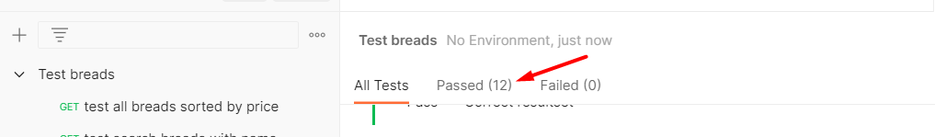
Result…
If you want to test the script again, you have to run the SQL script again...

Slide 68
More about how the Spring framework works
Spring Component Scanning
Inversion of Control IoC
Dependency Injection
see also "Explanation Spring Component Scan IoC DI.pdf" on Canvas

Slide 69
Spring Component Scanning
At the start of the application, Spring framework scans your code for @-annotations and registers them. The @Component annotations and the annotations derived from them such as @Controller and @RestController and @Repository, will be detected. In a @Controller or @RestController, the scan will also register which @... Mappings are all there, and then register them as connected to that particular controller they're in. In the end, the framework has a complete register of all @Controller, @RestController, @Repository, ... classes etc. in your project.

Slide 70
Inversion of Control (IoC)
For all classes or interfaces with @Component or with annotations derived from them such as @Controller, @RestController and @Repository Spring will perform Inversion of Control. In the past (without a framework) we always had control over the creation and management of instances of classes by creating instances/objects ourselves via new RecordController(). Spring will take that control out of your hands and create one instance for the classes or interfaces with the above annotations. In other words:
At the startup (in the background) of your program, Spring will create one instance/object of each Component, Controller, RestController, Repository-, ...-class and put it in the Spring Container. While running the application, at any time the application needs the item, it will offer it
Because only one instance of Components, Controllers and Repositories is created each time, these are Singletons.

Slide 71
Dependency Injection (DI)
In a Controller class that needs a Repository class, we do not create an object of this Repository class ourselves (e.g. with new RecordRepository().) It is much more efficient to use the one instance of RecordRepository that is in the Spring Container when your application is loaded... We can do this in several ways
1 way is by using the Constructor to specify an instance of a Repository Class via a parameter an other way is by putting the annotation @Autowired above the attribute (that of a class that contains the annotation @Component or one of the derived annotations such as @Controller and @Repository)
In other words, we do not handle this dependency (= association between Controller class and RepositoryClass) by creating an instance in the class itself, but by injecting an instance into the class from the outside. Hence the name Dependency Injection

Slide 72
Dependency injection
The video below explains very clearly what the term "Dependency injection" means in general outside the context of Spring Boot
Dependency injection - in general
The video below explains how to do dependency injection in Spring Boot
Dependency injection – in spring boot

Slide 73
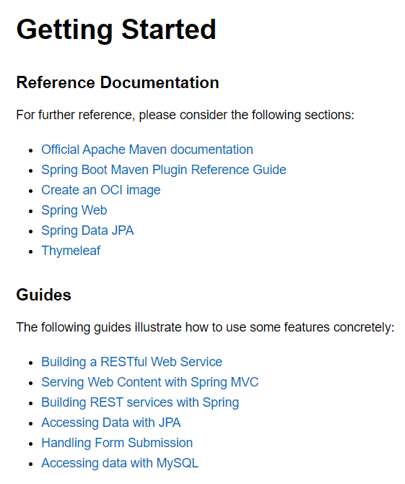
Documentation
See HELP.md in your project:

